Slide 1
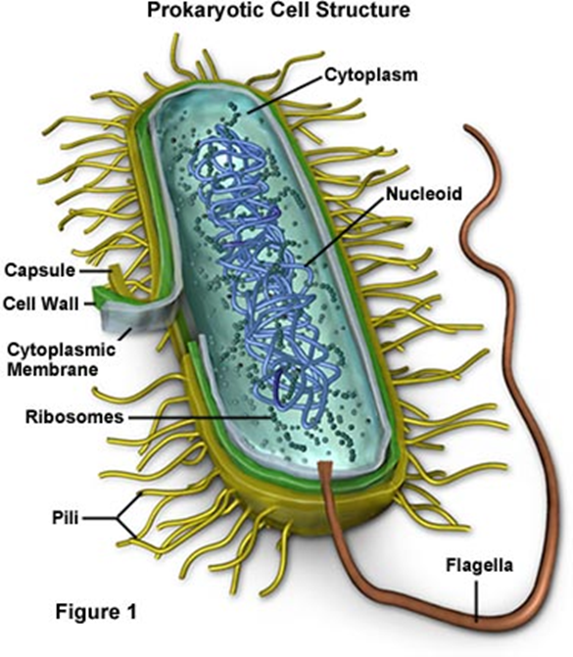
Classification, Structure ,morphology , growth ,movements and function of Bacteria
By
Dr. Hesnaa Saeed Al-Mossawi

Slide 2
Classification
Kingdom of monera is made up of simple single celled organisms.
Prokaryotic cells
Monerans’ have four Phyla
Phylum: Schizophyta- The largest phylum of Monera. Contains organisms commonly known as bacteria
Phylum: Archaebateria- primitive organisms that live in harsh climates
Phylum: Cyanophyta: Organisms known as blue-green bacteria
Phylum:Prochlorophyta: Monera that live in marine environments

Slide 3
Growth
It is an increase in all the cell components, which ends in multiplication of cell leading to an increase in population.
It involves - an increase in the size of the cell & an increase in the number of individual cells.
Bacteria divide by binary fission.

Slide 4
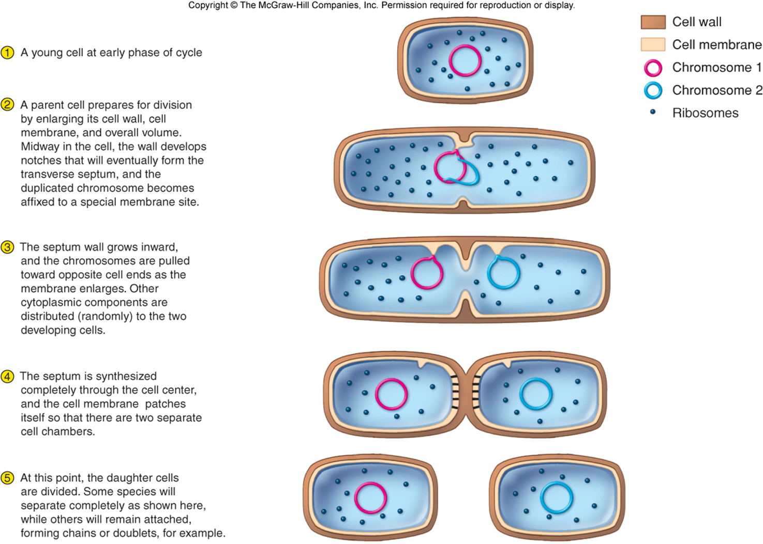

Slide 5
Structure of Bacteria
The cellular world is divided into two major groups, based on whether or not the cells have a nucleus (that is, an internal membrane-enclosed region that contains the genetic material). Cells that have a well-defined nucleus are called eukaryotic, whereas cells that lack a nucleus are called prokaryotic. All bacteria are prokaryotes.
Size of Bacteria
Average bacteria 0.5 - 2.0 um in diam.
Surface Area ~12 um^2
Volume is ~4 um
Surface Area to Volume is 3:1

Slide 6
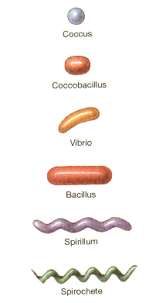
Shapes of Bacteria
Coccus
Chain = Streptococcus
Cluster = Staphylococcus
Bacillus
Chain = Streptobacillus
Coccobacillus
Vibrio = curved
Spirillum
Spirochete
Square
Star
Arrangements
Clusters, tetrads, pairs, chains

Slide 7
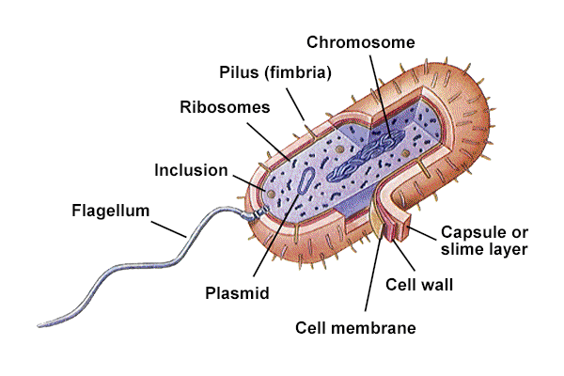
Bacterial Structures
Flagella
Pili
Cell envelope
Cell membrane
peptidoglycan
Capsule
Gram +
Gram-
Cytoplasm
Cell Wall
Spores

Slide 8
Flagella
Flagella: Prokaryotic flagella are long, semirigid, helical, hollow tubular structures composed of several thousand molecules of the protein flagellin. They enable bacteria to move in a directed fashion
Motility - movement
Swarming occurs with some bacteria
Spread across Petri Dish
Proteus species most evident
Arrangement basis for classification
Monotrichous; 1 flagella
Lophotrichous; tuft at one end
Amphitrichous; both ends
Peritrichous; all around bacteria

Slide 9
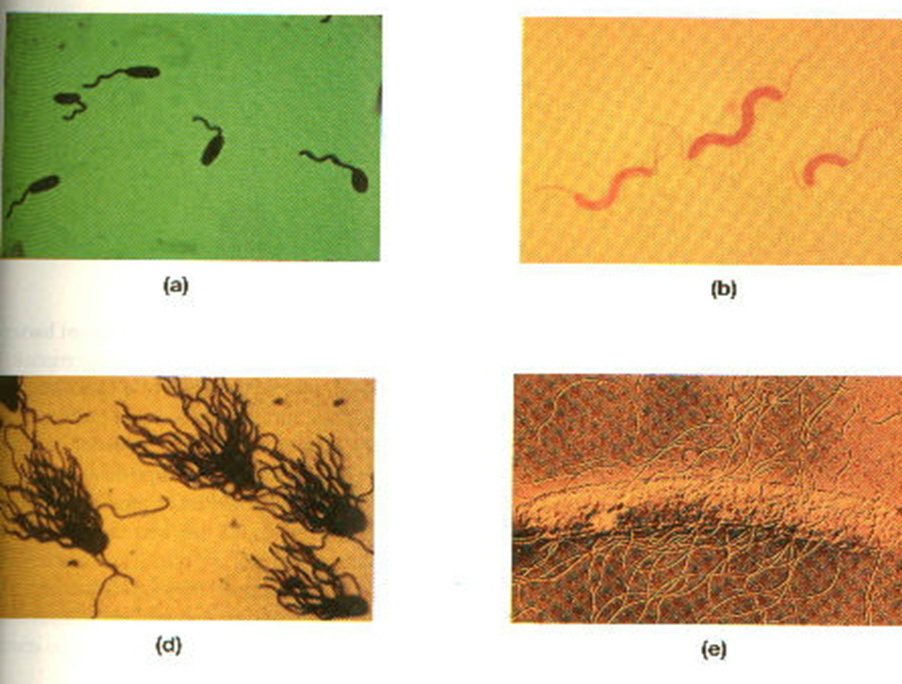
Flagella

Slide 10
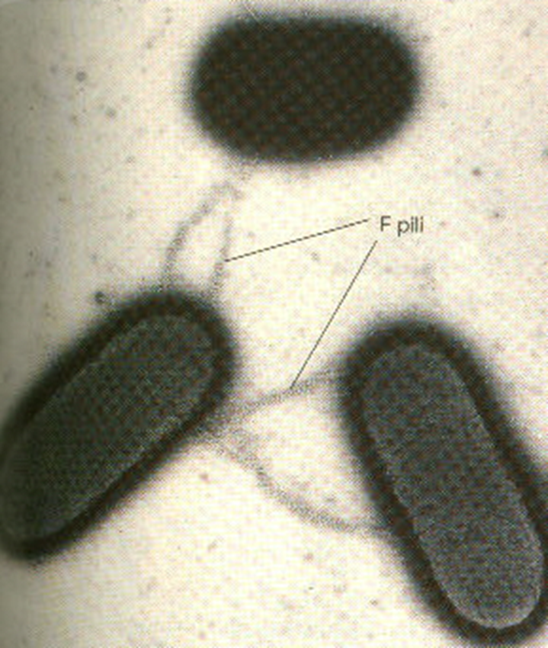
Pili
Short protein appendages
smaller than flagella
Adhere bacteria to surfaces
F-pilus; used in conjugation
Exchange of genetic information
Flotation; increase buoyancy
Pellicle (scum on water)

Slide 11
THE CELL ENVELOPE
The bacterial “cell envelope” is a term applied to all material external to and enclosing the cytoplasm. It consists of several chemically and functionally distinct layers
The cell envelope also includes the capsule or glycocalyx, if present.

Slide 12
C/ D-Capsule , Glycocalyx or Slime Layer
Is a sticky, viscous material that forms an extracellular coating around the cell. The material is usually a polysaccharide.
If the material is tightly bound to the cell and has an organized structure, it is called a capsule
If the material is loosely bound and amorphous, it is called a slime layer, or glycocalyx.
It allow cells to adhere to surfaces, protect bacteria from antibodies and phagocytosis, and act as diffusion barriers against some antibiotics and protect bacteria against dessication, or drying

Slide 13
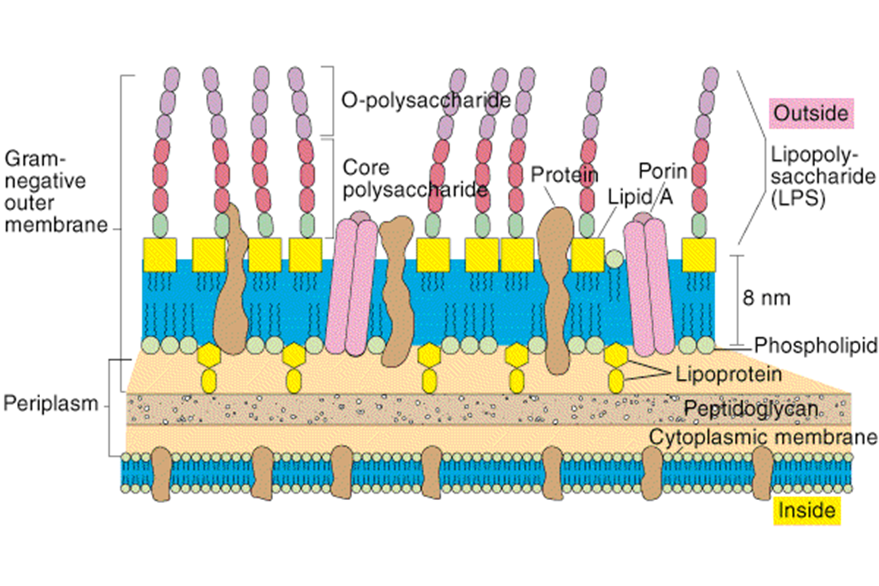
Cell envelope
B-peptidoglycan
Peptido-glycan Polymer (amino acids + sugars)
Unique to bacteria
Sugars; NAG & NAM
N-acetylglucosamine
N-acetymuramic acid
D form of Amino acids used not L form
Amino acids cross link NAG & NAM

Slide 14
Gram-positive organisms:
Gram-positive bacteria have thick, multilayered, peptidoglycan cell walls that are exterior to the cytoplasmic membrane.
The peptidoglycan in most gram-positive species is covalently linked to teichoic acid, which is essentially a polymer of substituted glycerol units linked by phosphodiester bonds.
The teichoic acids are major cell surface antigens. Teichoic acids are integrated into the peptidoglycan layers but not tethered to the cytoplasmic membrane.
Lipoteichoic acids are lipid modified and integrated by this moiety into the outer leaflet of the cytoplasmic membrane.

Slide 15
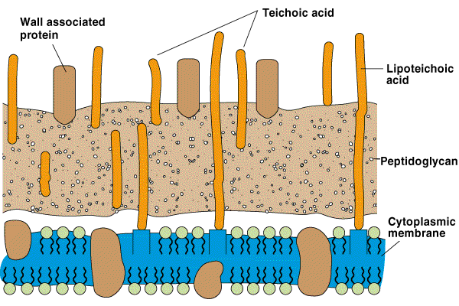
Gram positive

Slide 16
Gram-negative organisms:
Gram-negative bacteria have a more complex cell wall structure composed of two membranes (an outer membrane and an inner, that is, cytoplasmic, membrane).
The two membranes are separated by the periplasmic space, which contains the peptidoglycan layer. The periplasmic space also contains degradative enzymes and transport proteins.
In contrast to gram-positive cells, the peptidoglycan layer of gram-negative cells is thin, and the cells are consequently more susceptible to physical damage.
The outer membrane is distinguished by the presence of embedded lipopolysaccharide.

Slide 17
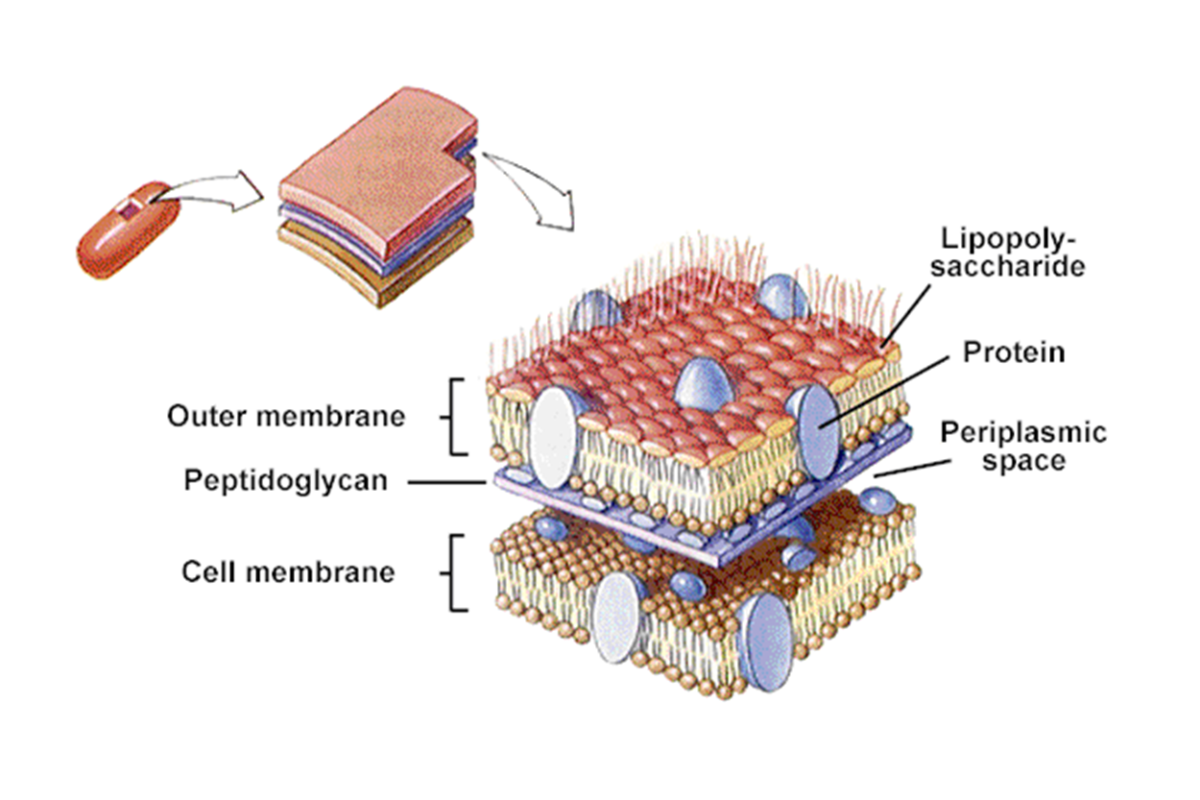
Gram-negative organisms:
Lipid A consists of phosphorylated glucosamine disaccharide units to which are attached a number of long-chain fatty acids
The lipid portion (called lipid A) is imbedded in the membrane and is toxic to humans and animals.
Because lipid A is an integral part of the membrane, it is called endotoxin, as opposed to exotoxins, which are secreted substances.
Appearance of Colonies
Mucoid = Smooth (lots of LPS or capsule)
Dry = Rough (little LPS or capsule)

Slide 18
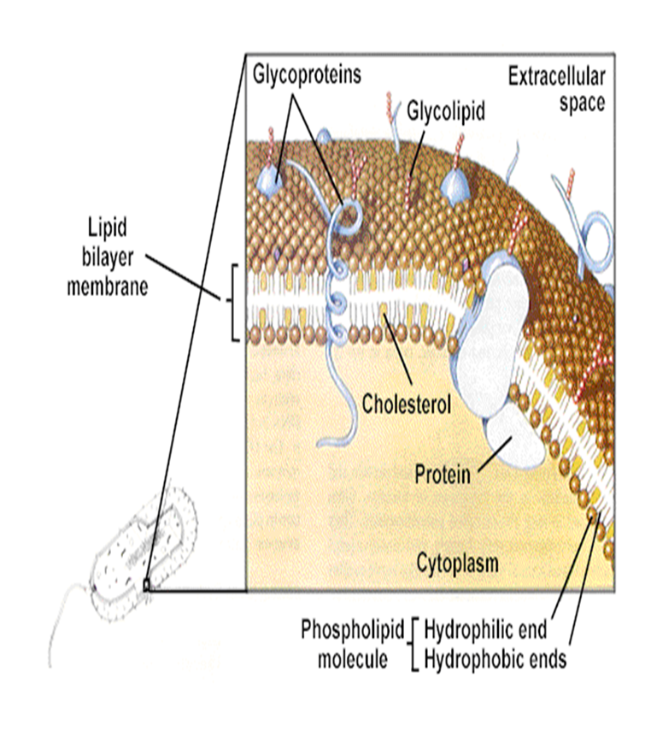
A. Cytoplasmic membrane
The cell membrane is composed of phospholipid, the molecules of which form two parallel surfaces (called a lipid bilayer) such that the polar phosphate groups are on the outside of the bilayer and the nonpolar lipid chains are on the inside. The membrane acts as a permeability barrier, restricting the kind and amount of molecules that enter and leave the cell.

Slide 19
Cytoplasm
80% Water {20% Salts-Proteins)
Osmotic Shock important
DNA is single circular molecule, called the bacterial chromosome. The chromosome, along with several proteins and RNA molecules, forms an irregularly shaped structure called the nucleoid. Plasmids; extra circular DNA
Antibiotic Resistance
Ribosomes: structure made of RNA, site of protein synthesis
Inclusions: granules of sugar, lipid storage, etc. (storage)
No organelles (Mitochondria, Golgi, etc.)

Slide 20
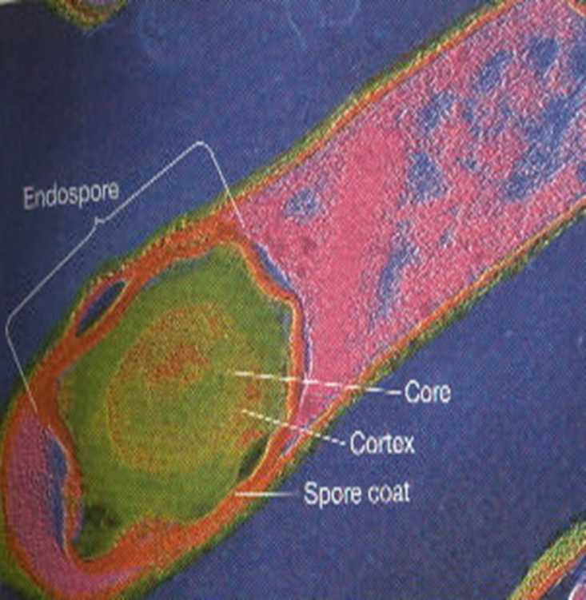
Endospores
Resistant structure
Heat, irradiation, cold
Boiling >1 hr still viable
Takes time and energy to make spores
Location important in classification
Central, Subterminal, Terminal
Bacillus stearothermophilus -spores
Used for quality control of heat sterilization equipment
Bacillus anthracis - spores
Used in biological warfare

